Slide 1



WELCOME TO Final Year B. Tech Project

Slide 2


SANT GAJANAN MAHARAJ COLLEGE OF ENGINEERING MAHAGAON, SITE-CHINCHEWADI
Department of Computer Science and Engineering
PROJECT TITLE : “Uncovering Industrial Trends By Analyzing data Using Power BI”
Guided By:-Asst. Prof. S. G. Swami
Group Members:
Roll No. | NAME | PRN No
42 | Borgave Revati Sanjay | 2020076665
43 | Patil Devendra Sunil | 2020081860
44 | Sutar Abhishek Rajaram | 2021076912
45 | Goilkar Rohan Ravindra | 2020080792

Slide 3
INDEX
Introduction
Objectives
Existing System
Proposed System
Proposed Work
Flowchart
Snapshots
Requirements
Advantages
Disadvantages
Future Work
Conclusion
References

Slide 4
INTRODUCTION
We're diving into a project to boost sales and smart decision-making for skateboard company.
Using a cool tool called Power BI, we'll look at company’s sales numbers, who's buying our boards, and how our marketing is doing.
The idea is to create dashboards that show us the important stuff in a clear and simple way. This way, we can make smarter choices, find out what our customers really like, and keep our skateboards rolling off the shelves!

Slide 5
OBJECTIVES
The main objectives behind this project are as follows:
Identify sales trends and patterns
Minimize returns and improve product quality.
Understand customer preferences and behaviours
Optimize inventory management
Identify profitable product categories
Enhance operational efficiency
Develop interactive dashboards for real-time insights
Enable data-driven decision-making

Slide 6
EXISTING SYSTEM
Lack of data analytics infrastructure.
Reliance on manual methods to track sales and returns.
Inability to identify regional trends efficiently
Challenges in optimizing sales and minimizing returns due to a lack of data- driven insights
Marketing strategies are not effectively enhanced
Current system limitations result in difficulties in increasing sales and reducing returns

Slide 7
PROPOSED SYSTEM
The proposed system utilizes Power BI to enhance data analysis capabilities at the boost sales and smart decision-making for skateboard company.
It involves integrating and transforming data, applying advanced analytics techniques, creating interactive dashboards, automating reporting.
This system aims to provide real-time insights, improve decision-making, optimize operations, and promote a data-driven culture within the organization.

Slide 8
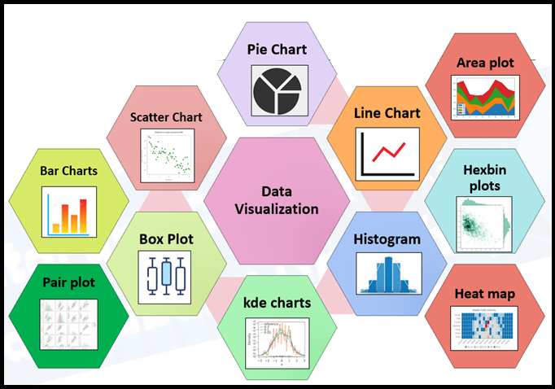

PROPOSED WORK
Data storing
Data cleaning
Data Transforming
Data-visualization

Slide 9
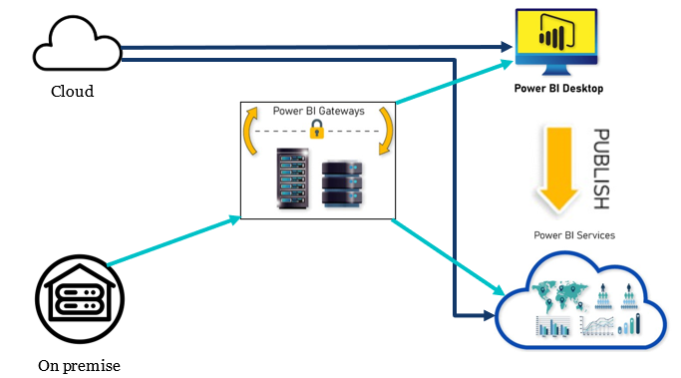

FLOWCHART

Slide 10
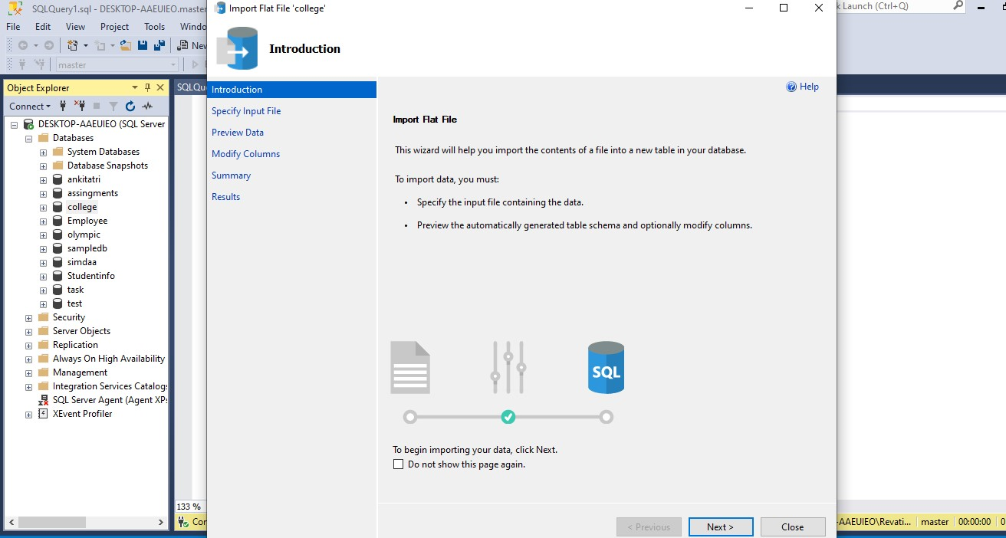
SNAPSHOTS

Slide 11
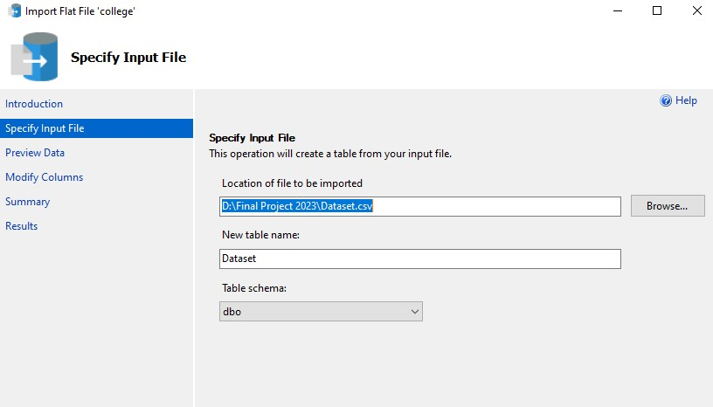

Slide 12
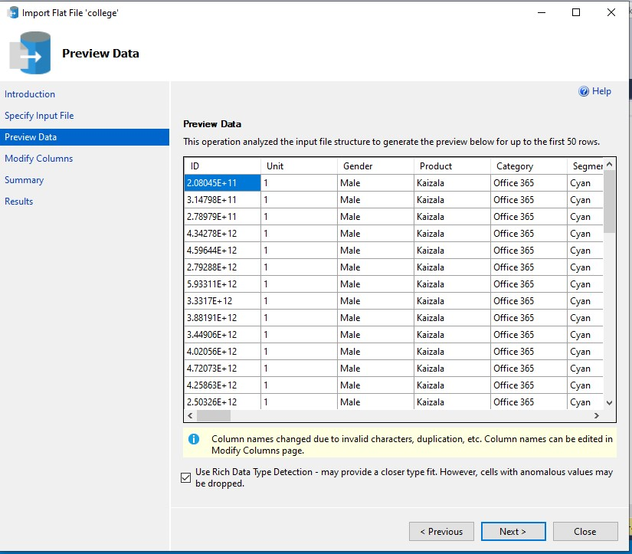

Slide 13
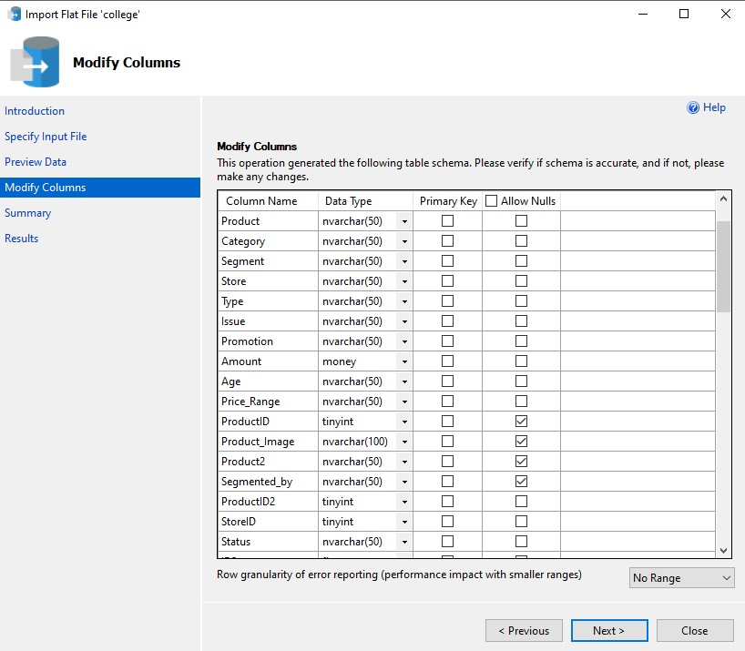

Slide 14
REQUIREMENTS
Hardware Requirement:
Processor : Intel core i3
Hard disk : Minimum 20GB
RAM : Minimum 4GB
Software Requirement :
Operating System: Windows 8
Dataset Storage: MySQL or SQL Server
BI Tool: Power BI, Power BI Report Services

Slide 15
ADVANTAGES
Enhanced insights and analysis capabilities
Real-time access to information for timely decision-making
Improved efficiency and streamlined processes
Optimization of operations and resource allocation
Visual clarity through interactive dashboards
Promotes collaboration and cross-functional analysis
Empowers data-driven decision-making for business growth.

Slide 16
DISADVANTAGES
Learning curve for Power BI implementation
Potential data quality challenges
Data privacy and security concerns
Dependency on technology with potential technical issues
Cost implications for implementation and maintenance

Slide 17
FUTURE SCOPE
Advanced predictive analytics for accurate forecasting
Real-time data integration for proactive decision-making
Personalized marketing and customer segmentation
Supply chain optimization for improved efficiency

Slide 18
CONCLUSION
In conclusion, the skateboard company currently faces significant challenges in optimizing sales and minimizing returns due to a lack of data-driven insights and an absence of essential tools like an interactive analytics dashboard. By addressing these issues and implementing a robust data analytics infrastructure, the company can not only identify regional trends but also enhance marketing strategies. These improvements are vital for achieving increased sales and reducing returns, ultimately leading to a more successful and efficient operation.

Slide 19
REFERENCES
Web references:
https://learn.microsoft.com/en-us/training/modules/introduction-power-bi/
https://www.youtube.com/watch?v=-_DJPRrFQXI&t=339s

Slide 20
THANK YOU!
ANY QUESTIONS?

